Slide 1


Slide 2
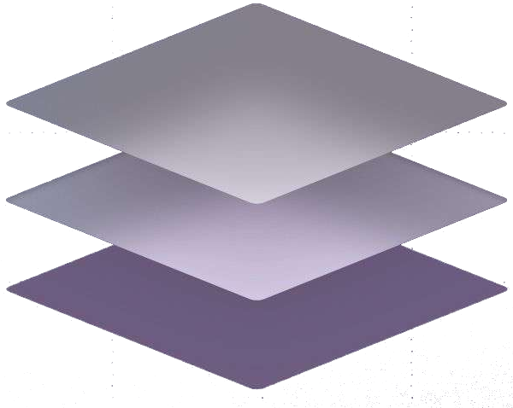
About today…
Layers
Layer Styles

Slide 3
Understanding Layers
Definition
Layers are like transparent sheets stacked on top of each other
allowing you to work on individual parts of your project without affecting other parts
Benefits
Flexibility in editing and adjustments
Organizing complex designs efficiently
Easier to apply effects and make corrections
Layer Panel
Located on the right side of the screen
Contains tools for creating, managing, and organizing layers

Slide 4
Basic Layer Operations
Creating New Layers
Click the “Create a New Layer” icon at the bottom of the Layers Panel
Use shortcut Ctrl+Shift+N
Layer Stacking Order
Layers at the top of the panel appear above layers at the bottom
Drag and drop layers to rearrange their order
Renaming and Grouping Layers
Double-click the layer name to rename
Select multiple layers and press Ctrl+G to group them

Slide 5
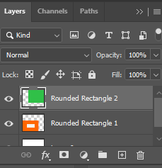
Layer Visibility and Locking
Toggling Visibility
Click the eye icon next to the layer to show/hide it
Locking Layer
Use the lock icons to prevent moving, editing, or transparency changes
Types of locks include position, pixel, and transparency lock

Slide 6

Layer Masks
Allow selective editing by hiding/revealing parts of a layer
Non-destructive way to blend layers together

Slide 7
Common Layer Styles
Drop Shadow
Adds depth and dimension by simulating a shadow
Inner Shadow
Creates the appearance of depth within the layer
Outer Glow
Adds a halo effect around the layer
Inner Glow
Adds a glow effect inside the edges of the layer
Bevel
Adds 3D effects to layers
Emboss

